Slide 1
Operating Systems
Dining Philosophers Problem

Slide 2
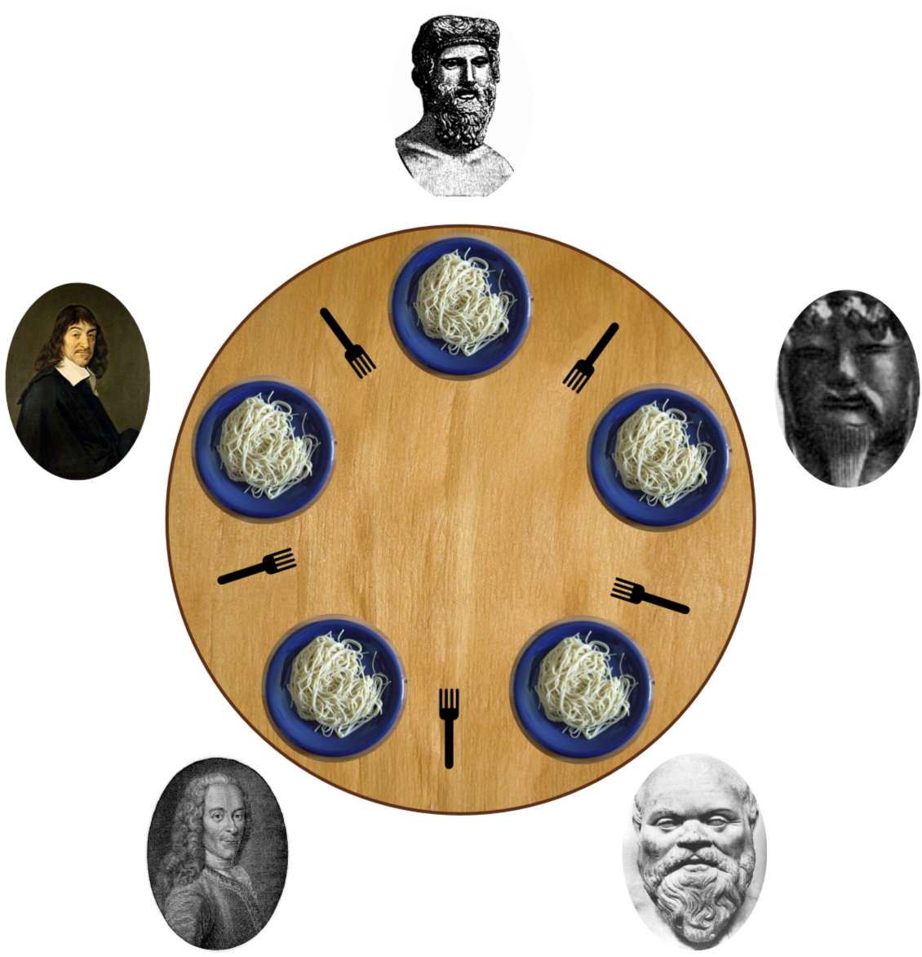
Dining Philosophers Problem
Philosophers in thinking or eating state.
When philosopher wants to eat he needs to use 2 forks but picks only one at a time, to his left and right.
No to philosophers adjacent to each other can eat at same time because of fork used by other one.
Resource allocation problem.
Here philosophers are processes and forks are resources.
Limited resources needs to be shared to multiple processes in synchronized manner.

Slide 3
Dining Philosophers Problem
Represent each fork with a semaphore
Philosopher picks fork by executing wait() operation.
Releases using signal() operation.
Shared data are semaphore fork[5]; // each fork has values 0 and 1.
0 implies fork is used 1 implies fork is free
All the elements of fork is initialized to 1 initially

Slide 4
Dining Philosophers Problem
The structure of Philosopher i:
do {
wait (chopstick[i] );
wait (chopStick[ (i + 1) % 5] );
// eat
signal (chopstick[i] );
signal (chopstick[ (i + 1) % 5] );
// think
} while (TRUE);

Slide 5
Dining Philosophers Problem
Dead Lock
Suppose all 5 philosopher become hungry simultaneously and each grabs left fork, then all the elements of fork will now 0.
When each philosopher tries to grab his right fork, he will be delayed forever.
How to Avoid Dead Lock
Allow at most 4 philosophers to be sitting simultaneously at the table.
Allow a philosopher to pick up the forks only if both are available (picking must be done in a critical section.
Use an asymmetric solution -- an odd-numbered philosopher picks up first the left chopstick and then the right chopstick. Even-numbered philosopher picks up first the right chopstick and then the left chopstick.

Slide 6
THANK YOU

